Slide 1

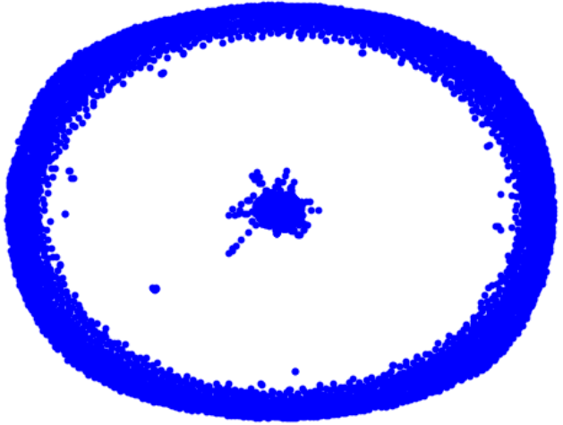
Capstone Project Phase B Graph Generation using Graph U-Nets
24-1-R-4
Yana Raitsin | Hanil Zarbailov
Supervisor: Dr. Renata Avros

Slide 2
Agenda
Project's Goals
Background
Solution Overview
Results & Analysis
Development Process
Challenges & Solutions
Evaluation of Project Benchmarks

Slide 3
Project's Goals

Slide 4
Project's Goals Need For The Project
A new approach for graph simulation using Graph U-Nets.
Improve upon Misc-GAN's efficiency and precision.
Fine-tune graph generation upon given prototypes.

Slide 5
Background

Slide 6
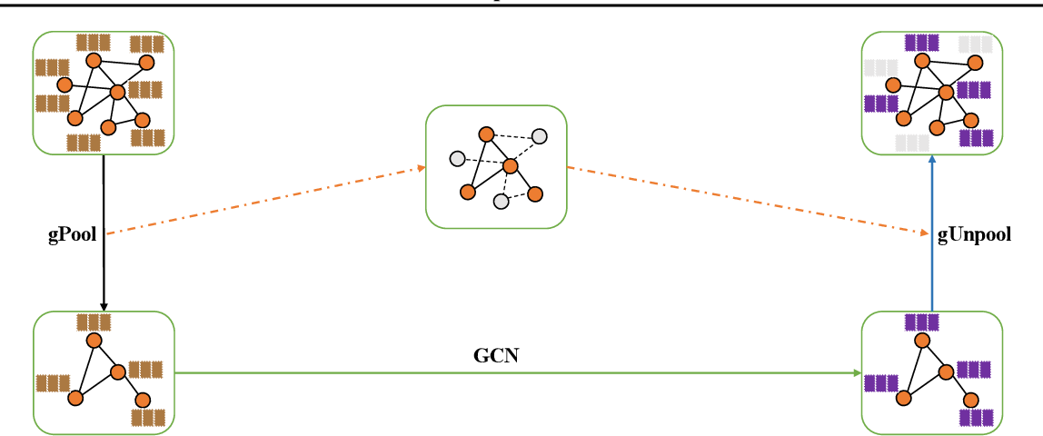
Graph U-Nets
An adaption of U-Net architecture for graph-structured data.
Key Components:
Graph Convolutional Layers: Perform convolution operations on graphs to capture local structures.
Pooling and Unpooling Layers: Coarsen and reconstruct graphs, preserving essential structures.
Skip Connections: Retain important features and improve gradient flow by connecting downsampling and upsampling paths.

Slide 7
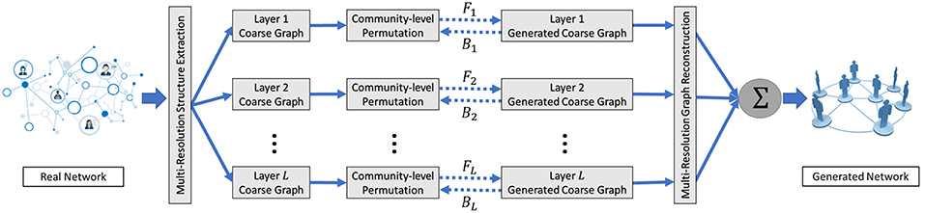
Misc-GAN
Sophisticated graph generation model – referencing model.
Captures complex relationships and hierarchies.
The architecture:
Multi-Scale Graph Representation Module.
Graph Generation Module.
Graph Reconstruction Module.

Slide 8
Background The Problem
The Problem with the Misc-GAN Model
Uses a statistical module for coarsening and reconstructing graphs.
Has limitations in graph generation precision.
Notes:
We took Misc-GAN as the base of our new approach in order to improve upon it

Slide 9
Solution
Overview

Slide 10
Solution Overview
Use Cycle-GAN to simulate synthetic coarse graphs at each granularity level.
Merge all synthetic coarse graphs into one final graph using G-Unpool of the trained Graph U-Nets and the Multi-Scale Graph Reconstruction module.
Training of a Graph U-Nets on a given underlying source graph(e.g., DBLP, PROTEINS).
Pre-Processing on a target graph(CORA, PubMed) to extract crucial data.
Coarsening graphs on different granularity levels using G-Pool operation of the trained Graph U-Nets.

Slide 11
Solution Overview Added Value
Our new approach uses Graph U-Nets to base coarsening and reconstructing upon node features (pooling).
The trained network is a new input parameter to the Misc-GAN model.

Slide 12
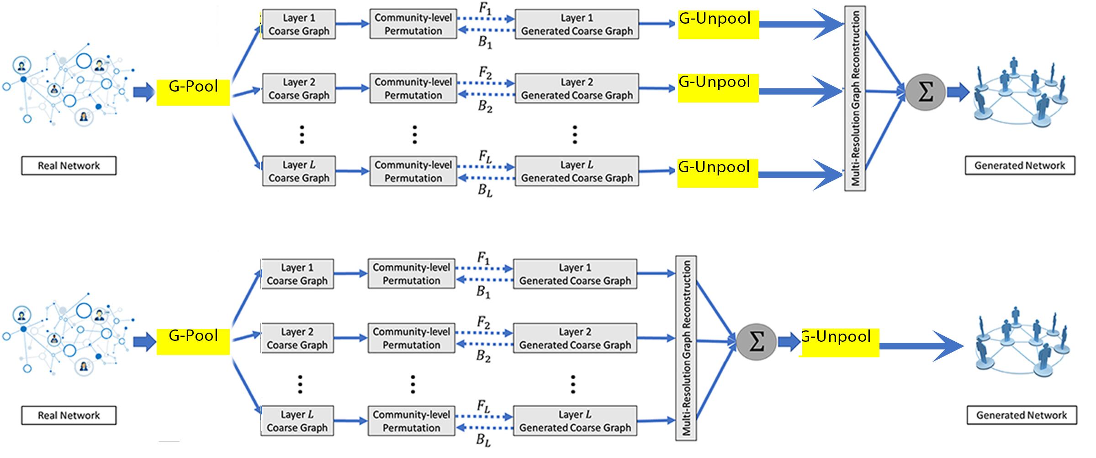
Solution Overview Architecture
I
II

Slide 13
Solution Overview Pre-Training
Allows us to fine-tune the model by training a Graph U-Nets on a dataset.
Datasets we used:
PROTEINS
DBLP
COLLAB
Notes:
Explain about datasets

Slide 14
Solution Overview Simulation Using Graph U-Nets
Simulate a target dataset using a Graph U-Nets network trained on another dataset.
Different combinations yield different results.
Datasets we used:
CORA
PubMed
Notes:
Explain about datasets

Slide 15
Results & Analysis

Slide 16
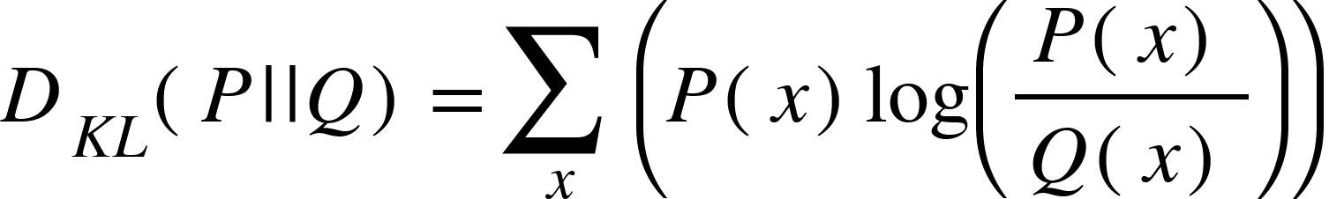
Background
Proximity Measures between generated graph and real graph distributions.
Identifies lack of diversity in generated graphs.
Evaluate the model's ability to generate unseen, realistic graphs.
Generally – Smaller means better.
Degree/Coefficient KL Divergence

Slide 17
Results & Analysis Explanation
The experiments' goals:
Comparison of the two approaches.
Compare different combinations.
Metrics:
Degree KL Divergence
Coefficient KL Divergence
Cora
12 chunks of PubMed.
In total – 78 experiments.

Slide 18
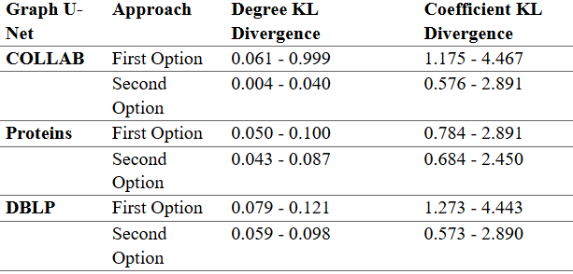
Results & Analysis PubMed

Slide 19
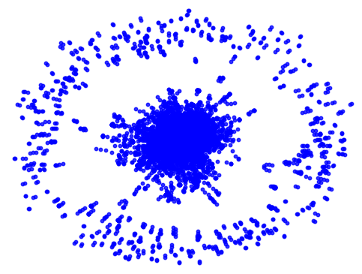
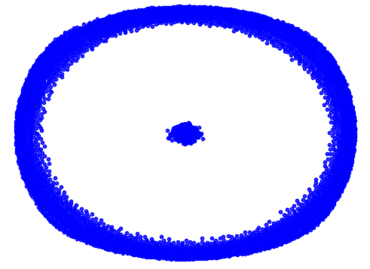
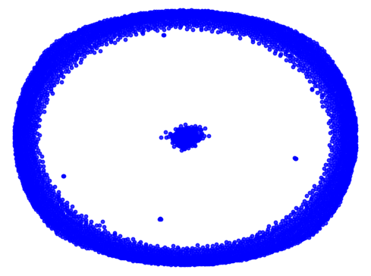
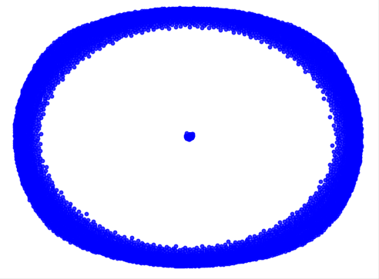
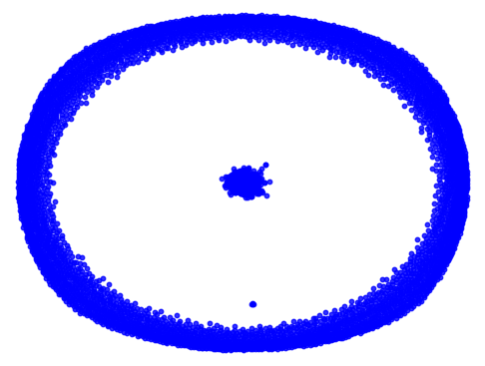
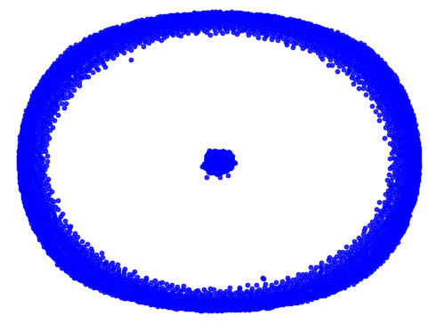
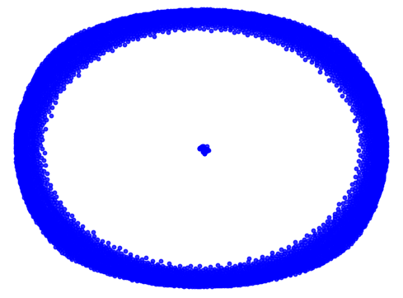
Simulated Graphs PubMed
Original
DBLP
PROTEINS
COLLAB
First
Option
Second
Option

Slide 20
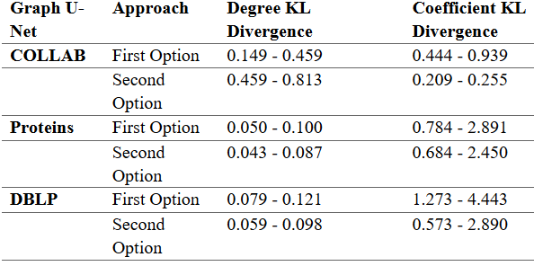
Results & Analysis CORA

Slide 21
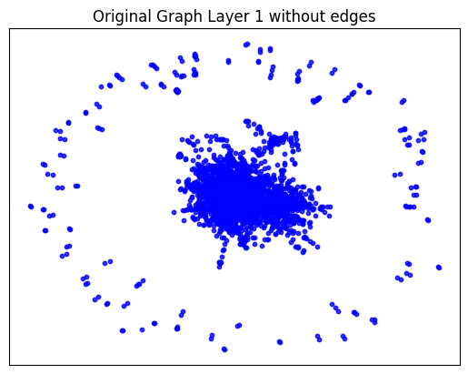
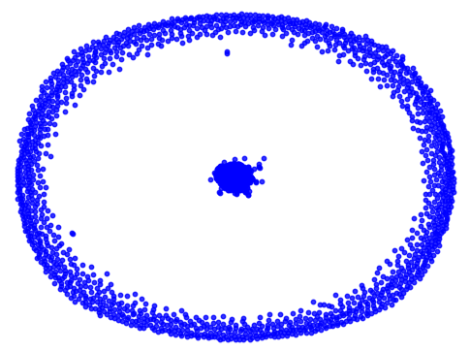
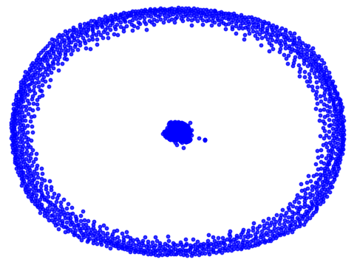
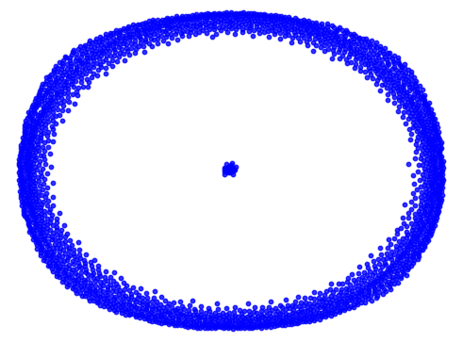
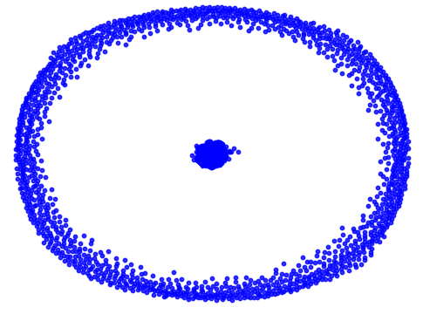
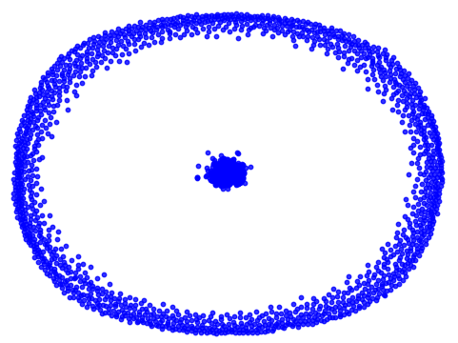
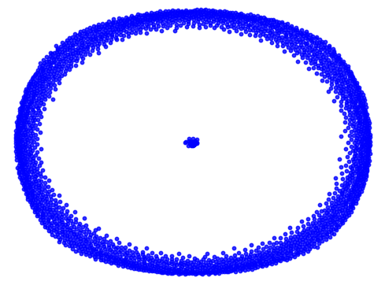
Simulated Graphs CORA
Original
DBLP
PROTEINS
COLLAB
First
Option
Second
Option

Slide 22
Results & Analysis Conclusions
Better results over Misc-GAN.
Second option wins.
Need more investigation and experiments to improve model.

Slide 23
Development Process
Researched Misc-GAN and explored the authors' GitHub repository.
Ran the code locally and discovered it's too slow and demanding.
Transitioned into Google Colab and began conducting first experiments.
Researched Graph U-Nets & integrated it into the model.

Slide 24
Challenges & Solutions

Slide 25
Challenges & Solutions
Low Memory on Local Machines
Access to better GPU, CPU, and RAM.
Rewriting Misc-GAN's Pre-Processing Module in Python
Took long, but worth it.
Modified architecture and data handling for node classification.
Adjusted PyTorch Geometric model for generalization.
Handling Large Datasets
Partitioned datasets into smaller chunks.
Enabled more experiments, enhancing robustness.
Moved to Google Colab Pro.
Rewrote the pre-processing module entirely in Python.
Adaptation of Graph U-Nets to Node Classification

Slide 26
Evaluation of Project Benchmarks

Slide 27
Evaluation of Project Benchmarks
Met and exceeded benchmarks despite challenges.
Improved upon Misc-GAN.
Handled tight deadlines.
Determined the best method.

Slide 28
Thanks!
Any Questions?

